Slide 1
Employee Data Analysis using Excel
STUDENT NAME : Daneshwaran D
REGISTER NO : 312212076
NAAN MUDHALVAN ID : 9F2421EBCD86633A3724796F21647F4A
DEPARTMENT : B. Com (GEN)
COLLEGE : MAR GREGORIOS COLLEGE OF ARTS & SCIENCE

Slide 2
PROJECT TITLE
Employee Performance Analysis using Excel

Slide 3
AGENDA
Problem Statement
Project Overview
End Users
Our Solution and Proposition
Dataset Description
Modelling Approach
Results and Discussion
Conclusion

Slide 4

PROBLEM STATEMENT
The objective of this project is to create an Excel-based employee performance analysis tool that will help the HR department and management.
By implementing this Excel-based performance analysis tool, the organization aims to enhance its decision-making process regarding employee management, foster a performance-driven culture, and ensure that employee contributions are aligned with the overall business strategy.
This will ultimately lead to improved productivity, employee engagement, and retention.

Slide 5

PROJECT OVERVIEW
Employee Performance Data Analysis is used to analyze the performance of employees by considering various factors such as achievements, ratings, gender, performance score., etc.
In order to identify the trends and patterns of different categories of employees such as high, medium and low performance for analyzing.

Slide 6






WHO ARE THE END USERS?

Slide 7

OUR SOLUTION AND ITS VALUE PROPOSITION
Condition Formatting
-To select the blank data and fill them with color.
Filter
-To remove the blank data for analyzing.
Formula
-To change the numerical data into text by using formula for easy analyzation.
Pivot Chart Analyze
-To summarize the excel data for further understanding and analyzing.
Graph
-For data visualization and understanding.

Slide 8

Dataset Description
Employee Data set – Edunet
Number of Features present – 26
Number of Features considered – 9
Employee ID – Numerical
Name – Text
Employee Type - Text
Gender – Male/Female
Employee Rating – Numerical
Performance Level – Text

Slide 9
THE "WOW" IN OUR SOLUTION
FORMULA
Performance Level =IFS(Z8>=5,”VERY HIGH”,Z8>=4,”HIGH”,Z8>=3,”MEDIUM”,TRUE,”LOW”

Slide 10
MODELLING
Data Collection
Downloaded from Edunet Foundation.
Then the datasheet is opened in Excel.
Feature Collection
Select the required column for analyzing.
Check for blank data in required column.
Data Cleaning
Select the column where the blank data is present.
Select conditional formatting option.
Fill the blank data with color.
Then select filter option and filter by color.

Slide 11
MODELLING
Analyzation
Select PivotChart analyze option.
Visualization
Now a bar graph showing different Trend is appeared.
In PivotChart analyze, select the required features for analyzing such as First name, Business unit, Gender code, Performance level.
Now choose business unit as axis and first names as values.
In the graph, we can observe the Employee and their performance levels in an Organization.
Different features can be compared according to gender and performance level using this graph in Excel.

Slide 12
RESULTS

Slide 13
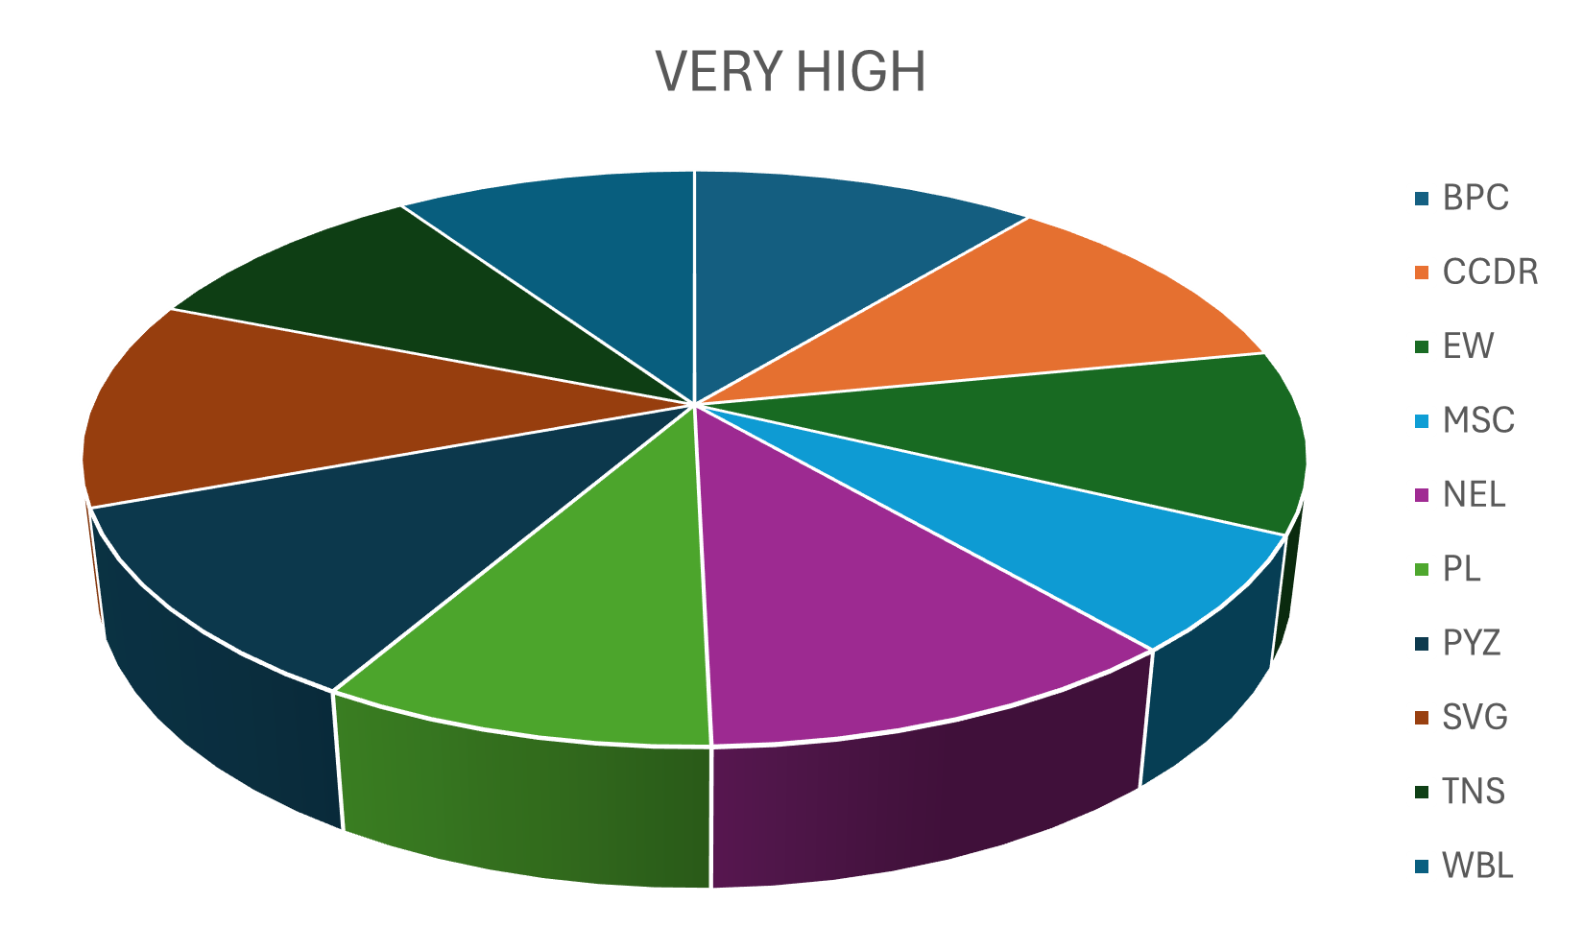
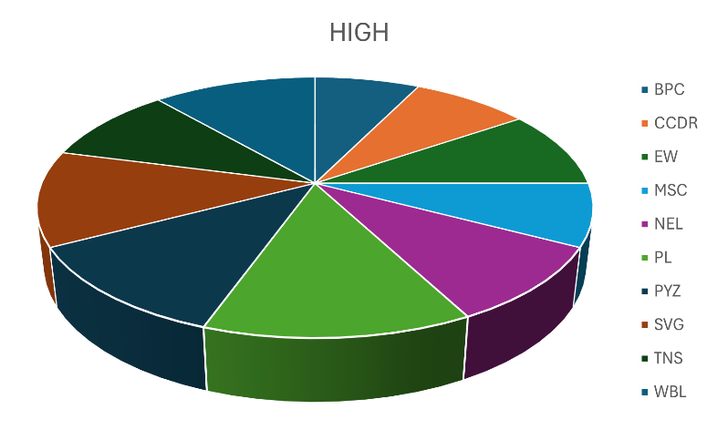
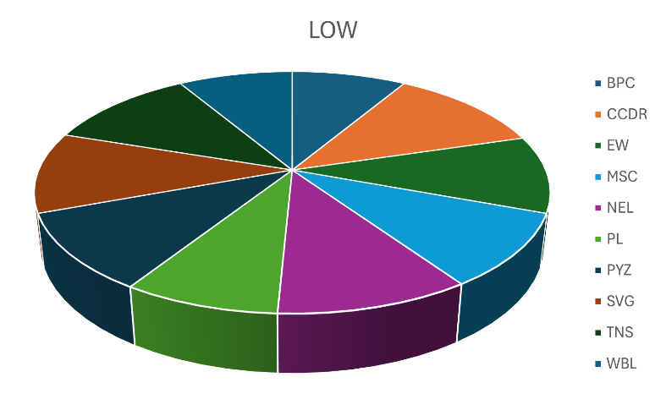
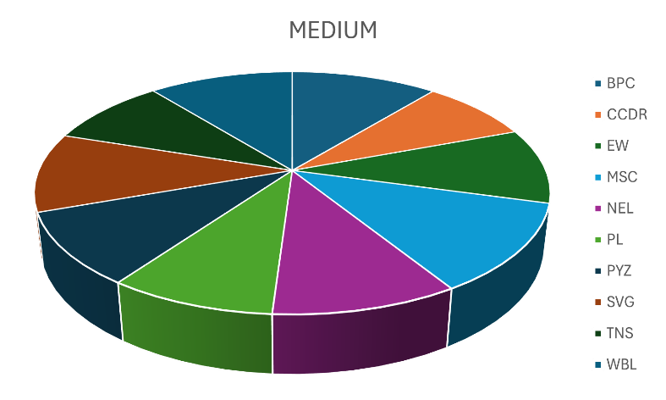
RESULT

Slide 14
conclusion
From the Employee data performance analysis using Excel, Medium performance employee are higher than others in the organization.
High performance employee are so lesser in number.
They have to be motivated by giving different levels of tasks, incentives and help them rise their performance for better productivity of the organization.

